Slide 1


Language Learning Application
Hi!
Aluu!
Salut!
Jambo!
Oi!
Supervisor: Mr. Alex Keselman Students: Oneill Panker & Roman Gury

Slide 2
Agenda
01
02
03
04
Introduction
Solution
Model Architecture
Challenges

Slide 3
Introduction

Slide 4
Introduction
An estimated half of the world’s population is bilingual
Learning new languages is standard in primary and secondary education across the globe
Online learning courses typically suffer from low retention rates
Courses often lack clear instructions, examples and support for the students
Notes:
● Learning a second language has become standard in the modern age. An estimated 50% of the world population is at least bilingual and the acquisition of new languages is standard both in primary and secondary education across the globe.
● A large part of the learning is done using online courses, thanks to their availability on the internet and their and low price
● While countless students take language courses every day, far fewer students see them to completion: studies on the retention rate of students taking online courses show very low retention rates, indicating that there is room for improvement when it comes to online learning methods.
● Among the reasons for high student dropout rates are a lack of structure, a need for clear instructions and examples that online courses do not always provide
● Online courses often lack proper support for the students: A question cannot always be answered in real time.
● Many students taking online language courses also tend to be older than conventional students and can't always dedicate an extended amount of time for studying. They need to balance the learning process with family, work etc.

Slide 5



Existing Solutions
Amount of content varies from one language to another
Reliance on repetition
Limited vocabulary diversity
Limited Interactive dialogue support
Limited amount of exercises
No dialogue practice
Notes:
● Babbel focuses on teaching the grammar through the lessons, providing more detailed explanations than its counterparts, however the app is also more repetitive and monotonous
● Rosetta Stone provides a more immersive learning experience, mimicking a natural learning process where the learner has little information in his native language to fall back on. But that lack of translation can make understanding the complex concepts more confusing. The lessons are also longer than in the other apps, making it harder for some students to study on a consistent basis.
● Duolingo focuses on a more gamified approach than the other two apps, with shorter and more varied exercises
● All apps are more limited in terms of the number of available exercises, meaning that students might encounter the same questions more often

Slide 6
Solution

Slide 7

AI Driven Application
Hi!

Slide 8

Solution
The use of personalized language paths, tailored for the user's levels and preferences with the help of AI
Interactive dialogues with ChatGPT to simulate real conversations
Daily challenges and quizzes to engage and test users
Gamification elements like points, badges, and levels to motivate learners

Slide 9
Gamification
Engagement
Motivation
Learning and Retention
Incorporates elements such as points levels and achievements to make tasks more compelling
Challenges, rewards, and personalization encourage the user to keep interacting with the app
Gamification helps reinforce learning, and its interactive nature improves retention, making the educational experience more enjoyable
Notes:
Gamification is the application of game design elements and principles in contexts outside of games
Engagement: Gamification incorporates points, levels, and achievements , to make the tasks more compelling.
Motivation: The features of gamification encourage the user to keep interacting with the application and strive towards specific goals.
Learning and Retention: By providing immediate feedback and creating a sense of progression through levels or challenges, gamification helps reinforce learning and improve retention. The interactive and repetitive nature of gamified tasks supports memory retention and skill acquisition, making it easier for users to remember and apply what they have learned.

Slide 10



The Result

Slide 11
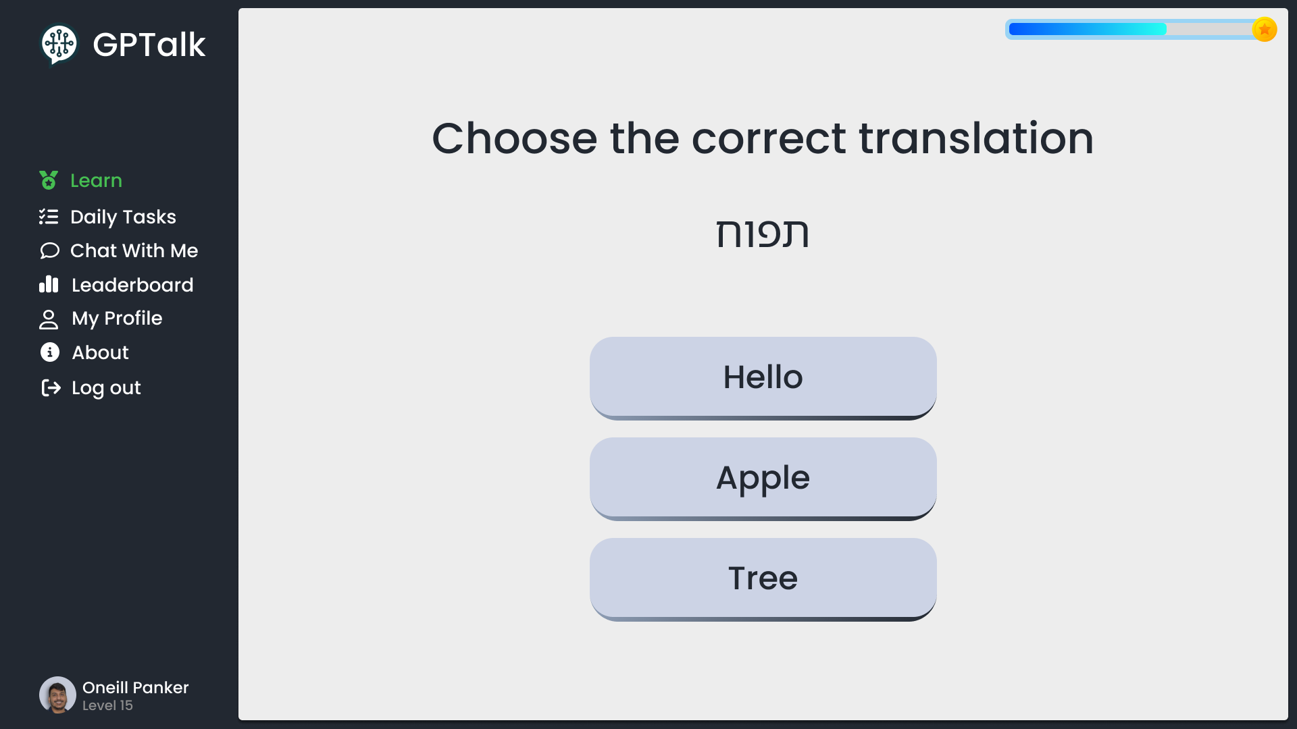
Example Exercise

Slide 12
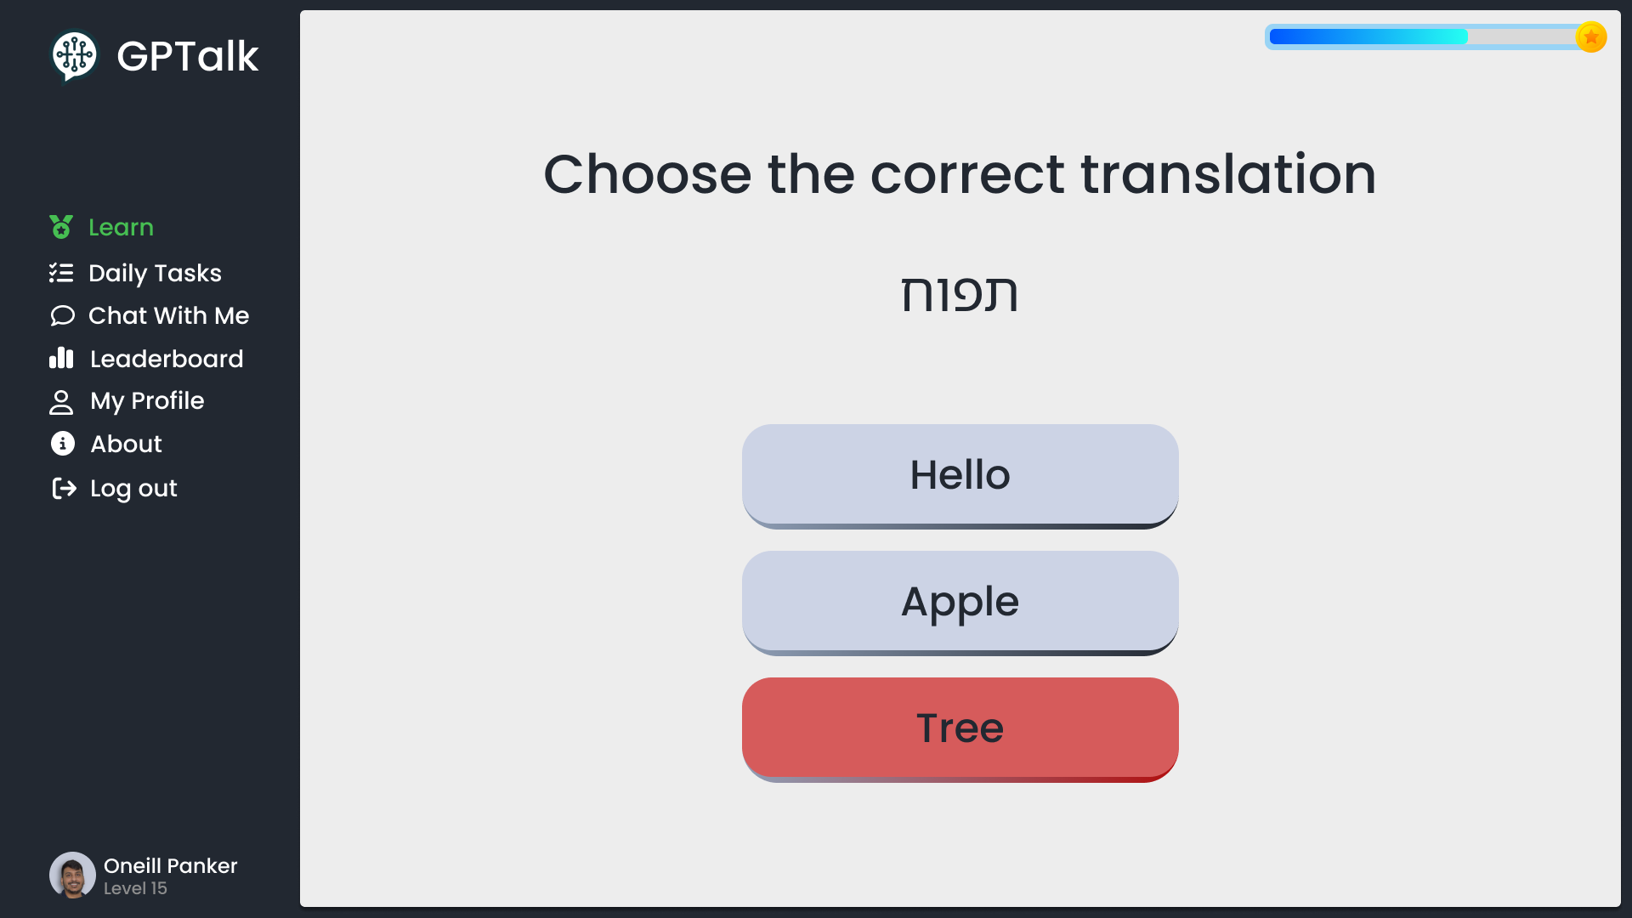
Example Exercise

Slide 13
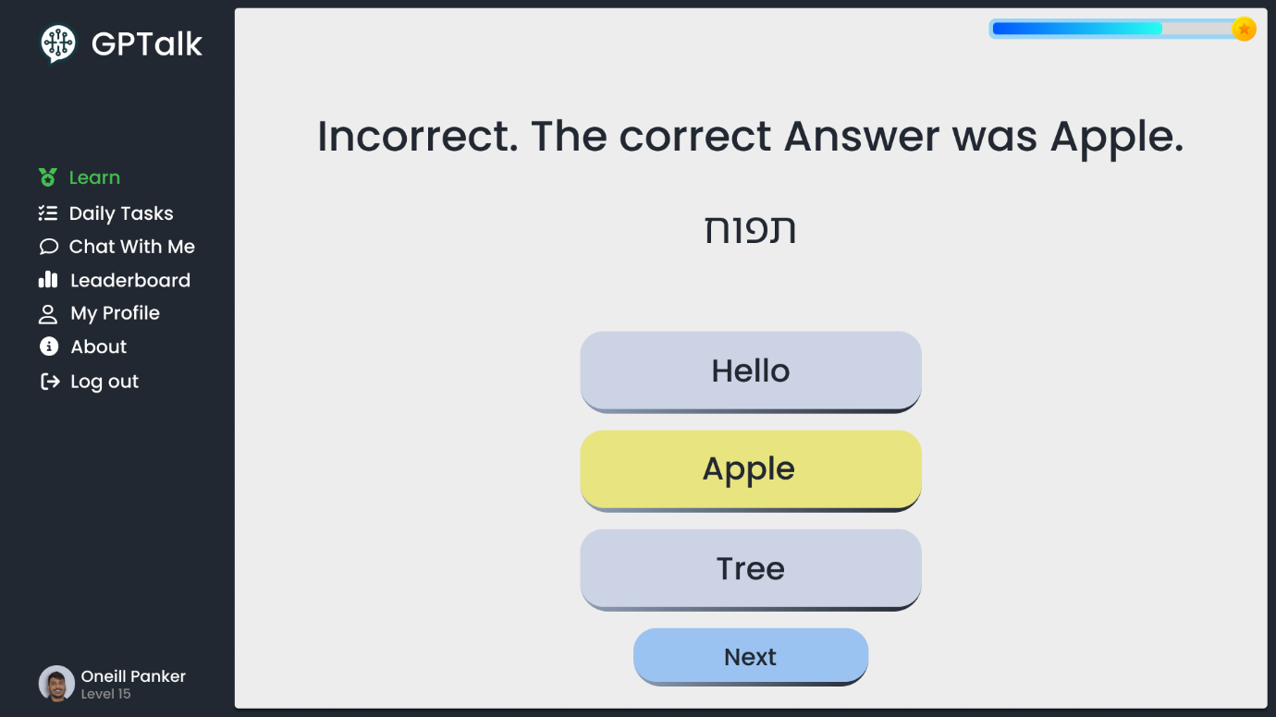

Example Exercise

Slide 14
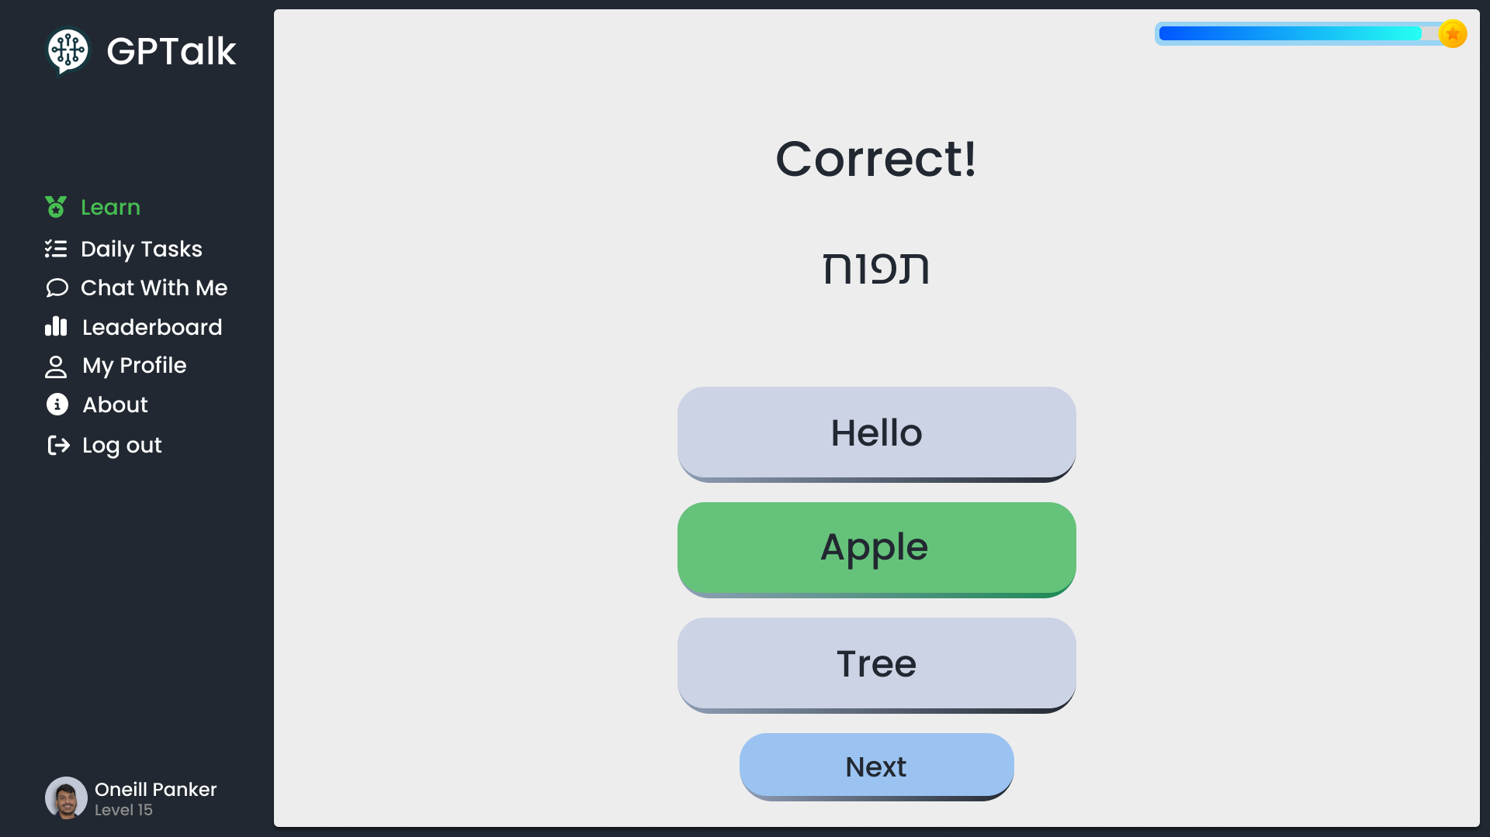
Example Exercise

Slide 15
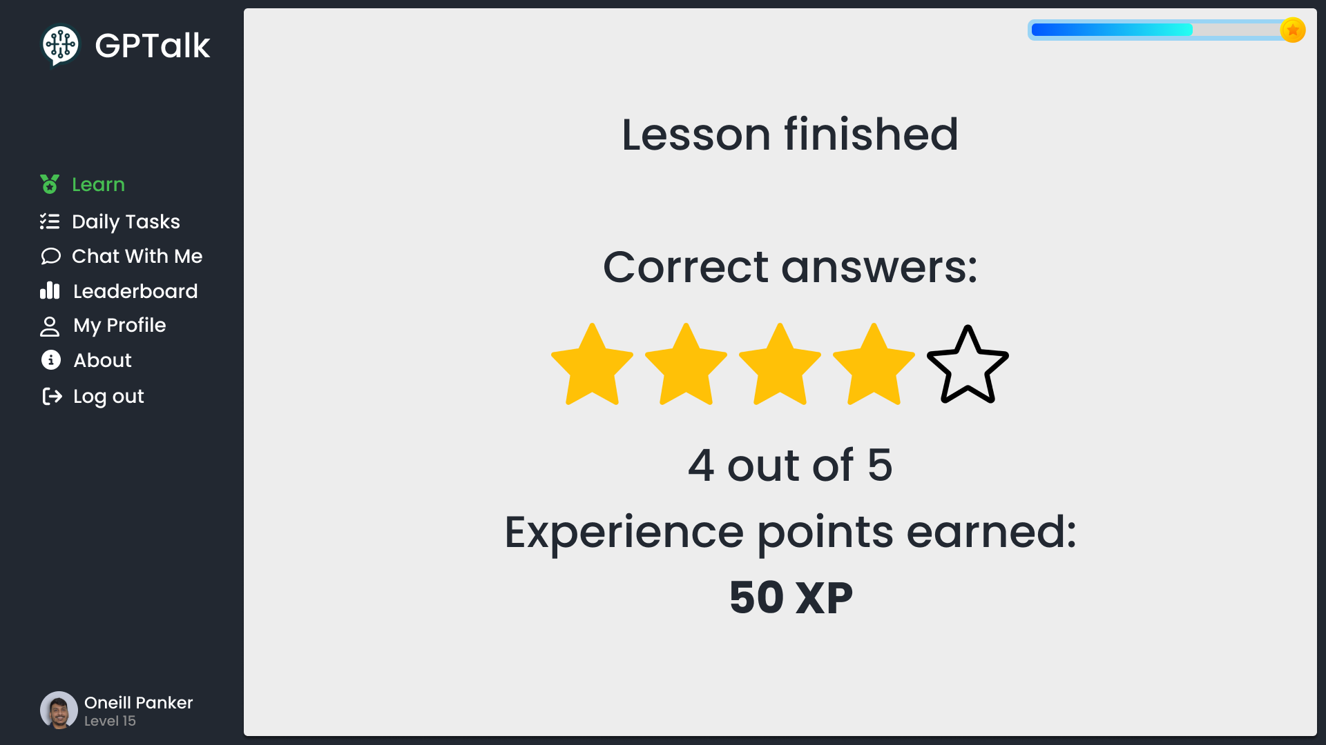
Example Exercise

Slide 16
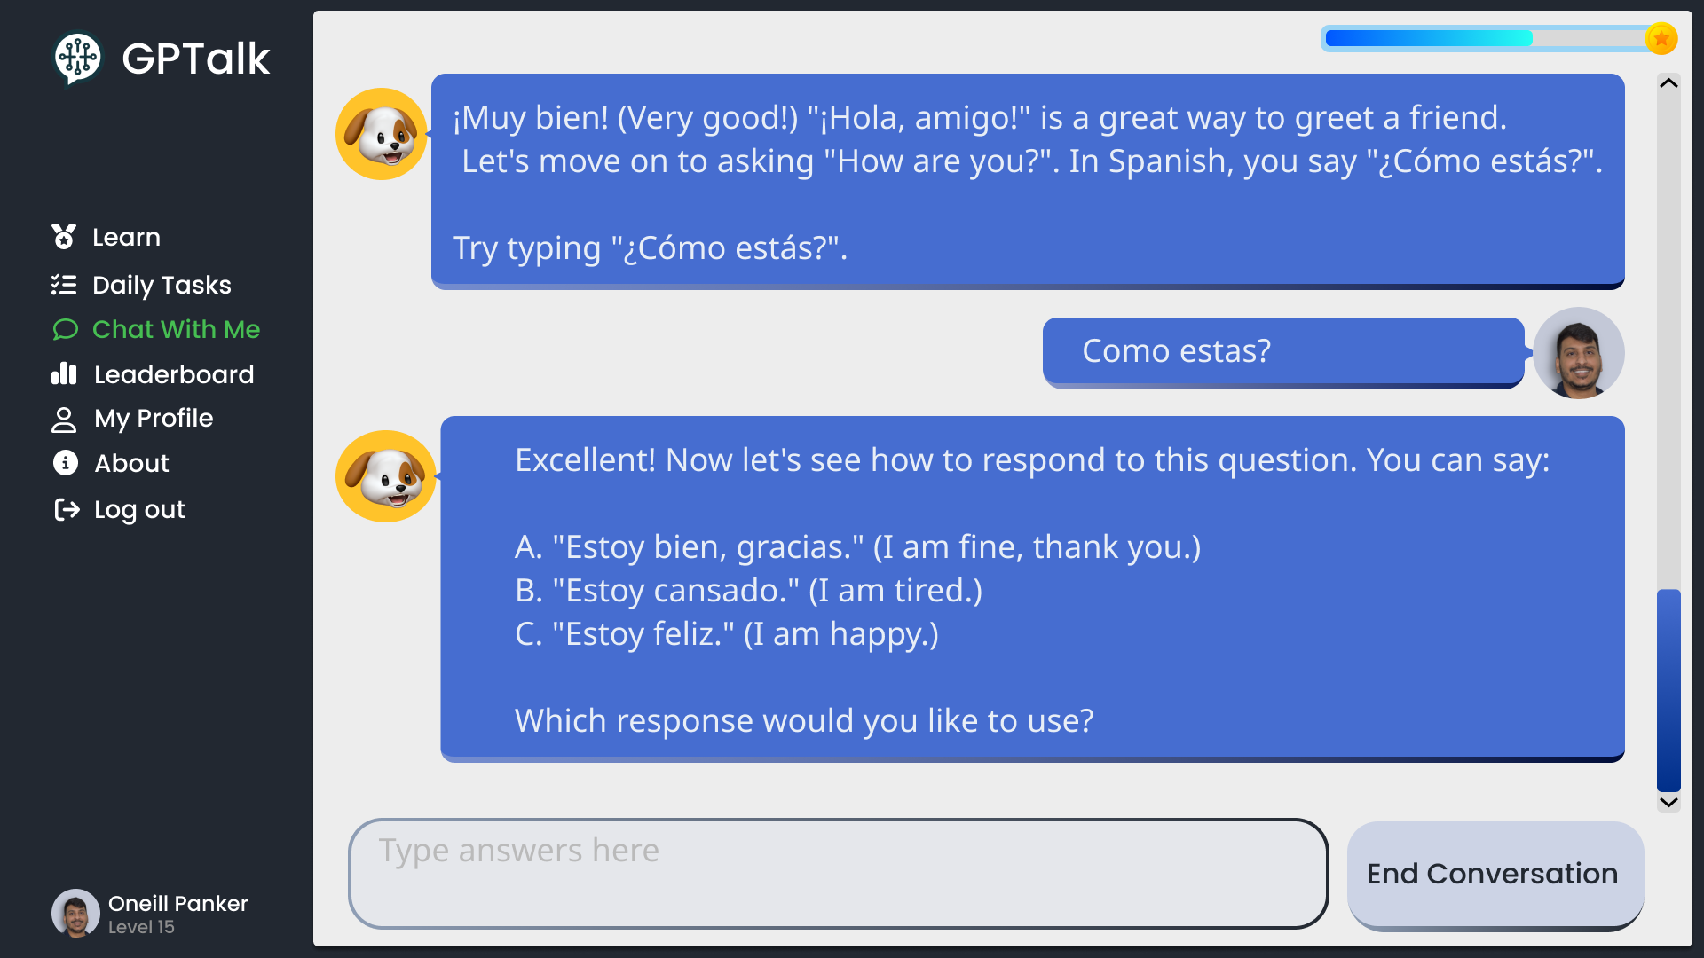
Example Chat

Slide 17
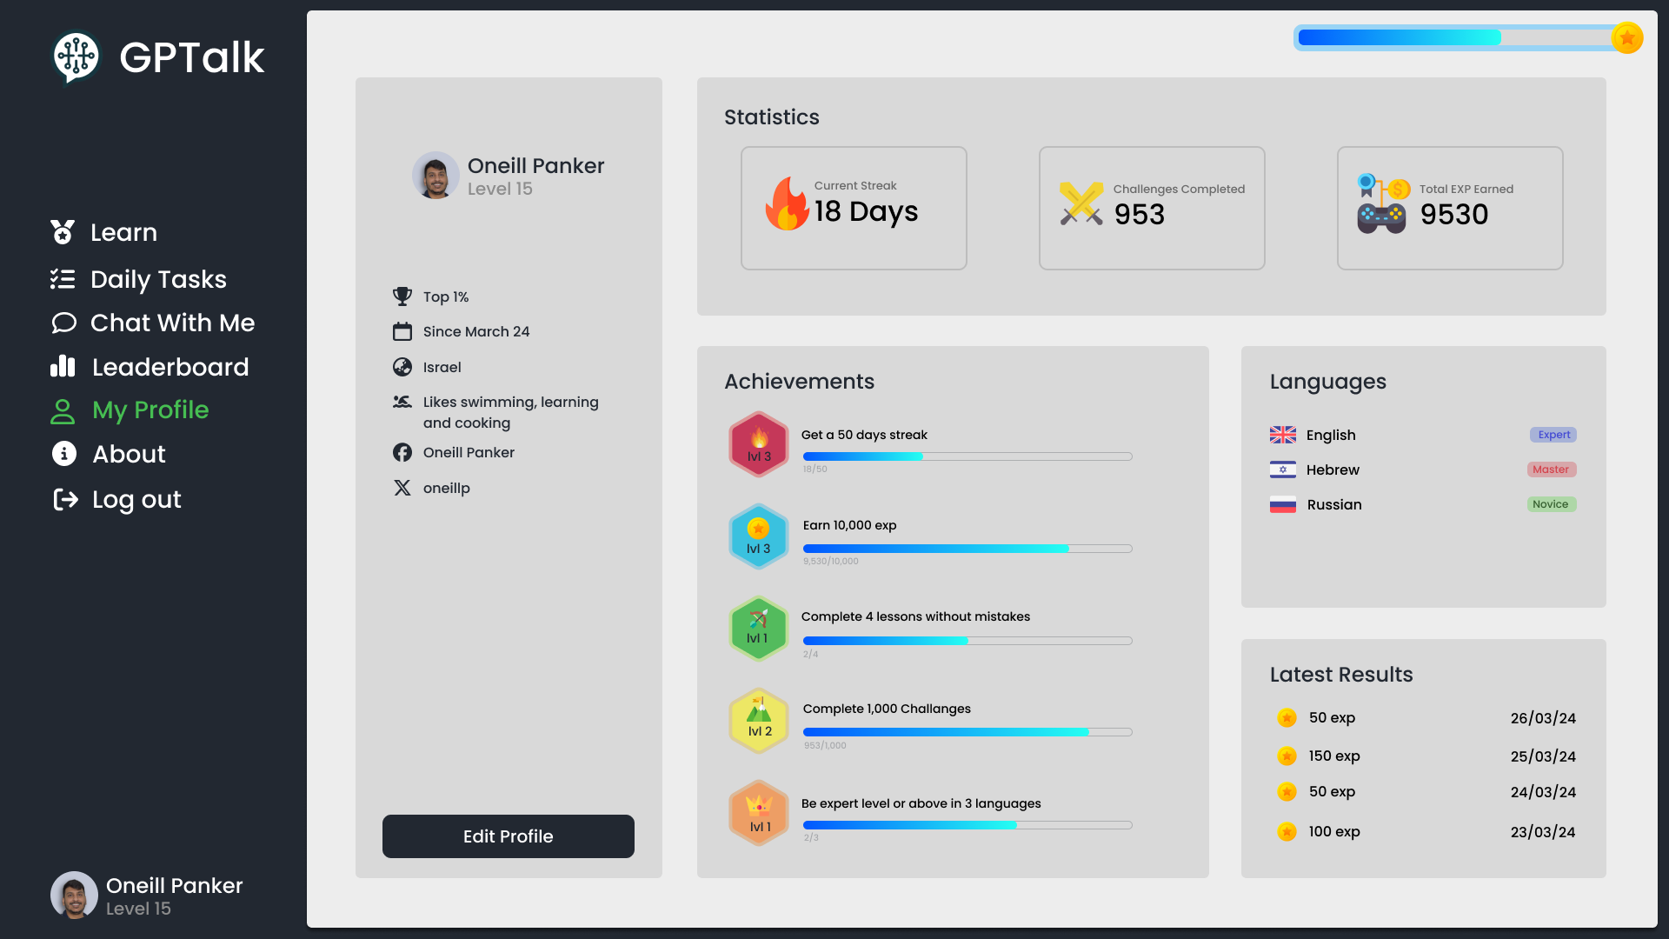
Dashboard
Notes:
In the center, we’ve got the statistics! Here, you can see an 18-day streak, 953 challenges completed, and 9530 experience points.
Below that, the achievements section shows all the badges and milestones you’ve hit, like maintaining a streak and earning tons of EXP. It keeps you motivated and proud of your progress.
On the right, the languages section tracks your proficiency. This user is at an expert level in English, master in Hebrew, and novice in Russian.
Finally, the latest results section gives a quick look at recent activities and the EXP earned.
We designed this dashboard to make learning fun and keep you motivated with clear goals and rewards.

Slide 18
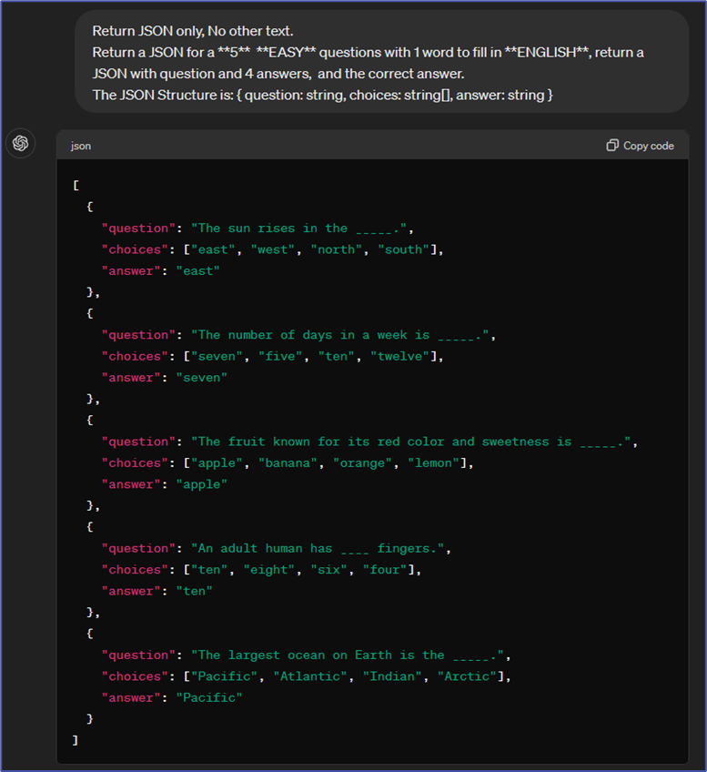
ChatGPT Prompts
Notes:
Specifying the output format (JSON), without additional text in the response.
Using a prompt template to allow the use of dynamic parameters in the prompts.
Limiting the number of questions in the response.
Specifying language of the exercise we are generating.
Specifying the difficulty of the generated exercise.
Specifying the type of the generated exercise.
Requesting the generated response to be printed in a specific structure.
Usage of various keywords to get a more accurate result.

Slide 19




Technology Stack
Angular
Express.js
MongoDB
ChatGPT
For responsive and dynamic UI
Efficient server-side logic
Flexible data storage
Interactive content generation

Slide 20
Application Architecture

Slide 21

Application Architecture
ChatGPT
Send prompts /
Receive responses
Use the
website
Send / Receive
requests
Client
Server
User
Save / Retrieve
data
Database

Slide 22
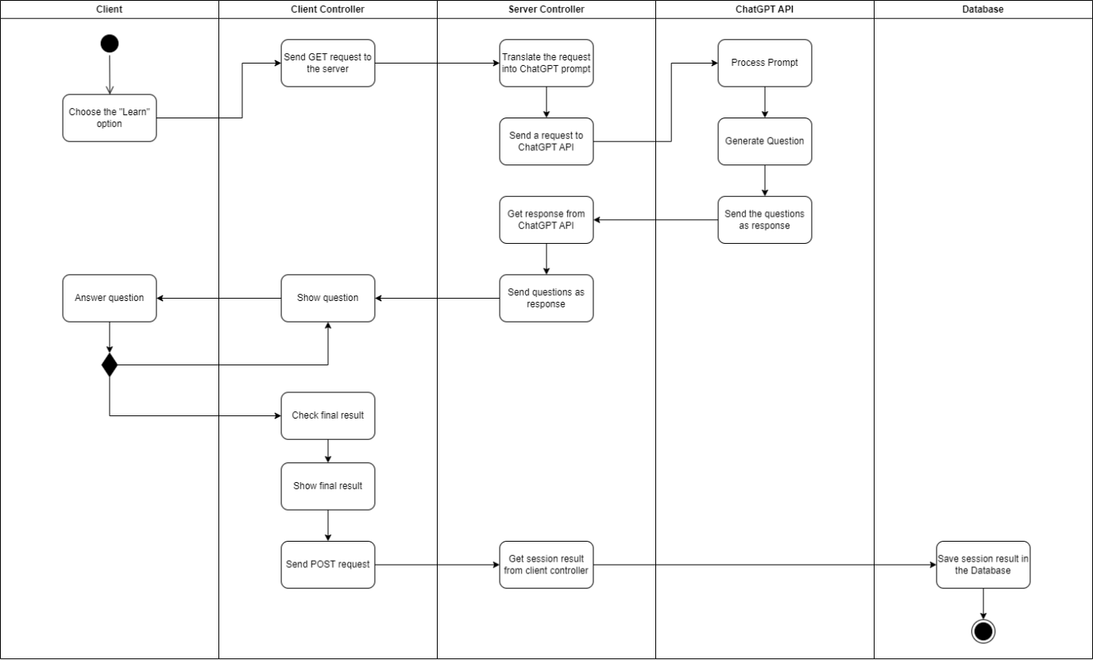
Activity Diagram – Learning Session

Slide 23
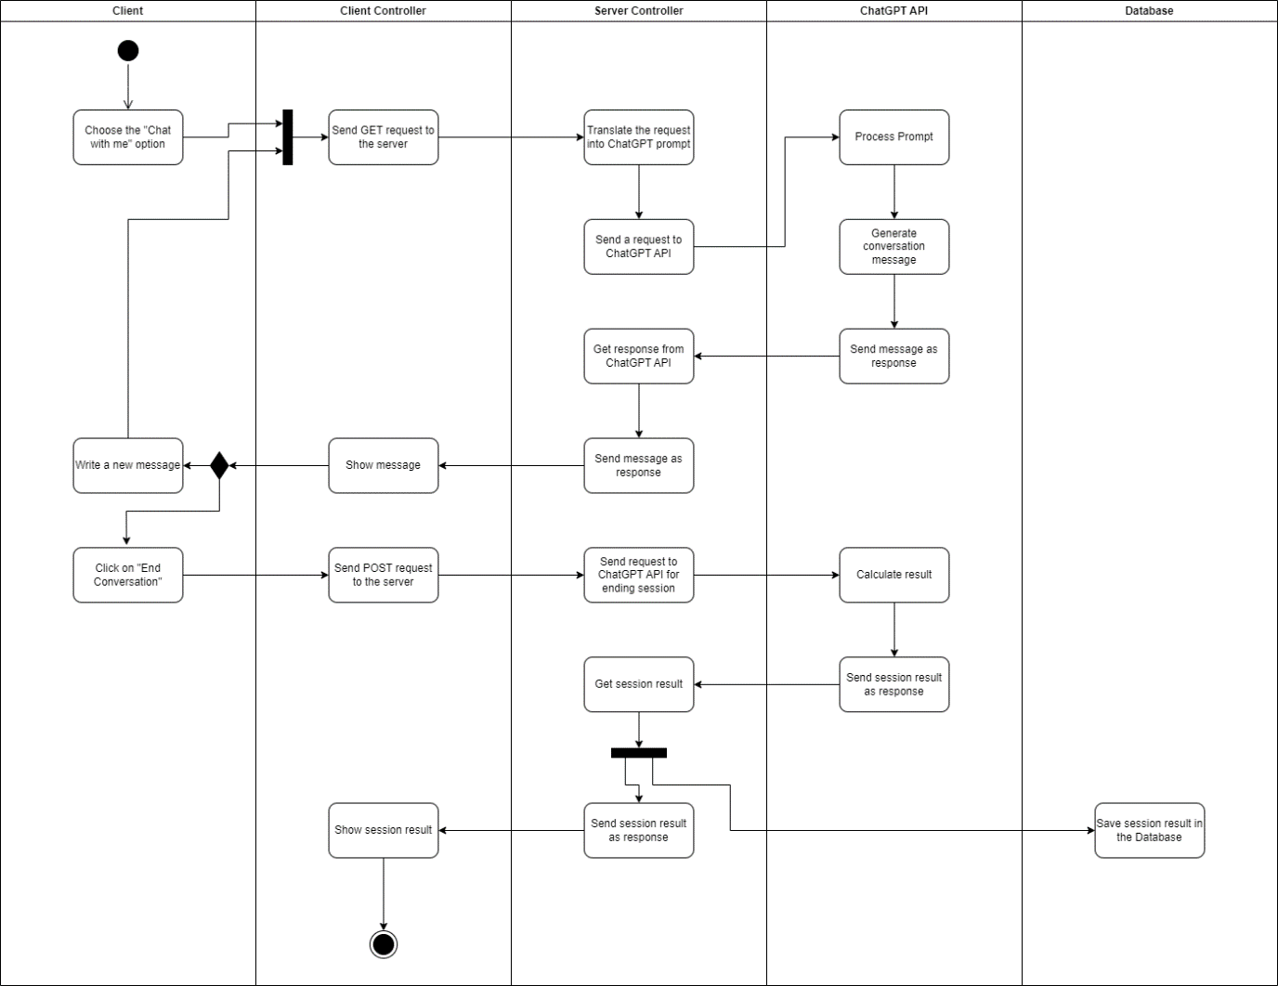
Activity Diagram – Chat Session

Slide 24
Verification
Test Name | Description | Expected Result
Login & Logout functionality | The user clicks the login/logout button | The system successfully logs the user in/out
Sidebar navigation | The user clicks a nav item on the sidebar | The user is redirected to the relevant page
Chat mode functionality | The user enters the “chat with me” page and starts a conversation | The user successfully completes a conversation with the ChatGPT chatbot
Learn mode functionality | The users enters the “learn” page and starts a lesson | The user completes a full lesson
Leaderboard functionality | The user enters the “leaderboard” page | A list of high scores by fellow users is displayed on the page
My Profile functionality | The user enters the "My Profile" page | Displays the details of the user currently logged in
About page functionality | The user enters the “About” page | Displays technical information about the application

Slide 25

Challenges
Integration Complexity
Accuracy and Reliability
Scalability
User Experience
Notes:
Integration Complexity
Combining ChatGPT with out custom systems.
Ensuring seamless data flow between frontend, backend, and database.
Accuracy and Reliability
Maintaining high accuracy in language tasks generated by ChatGPT.
Handling varied user inputs and providing relevant feedback.
Scalability
Designing the backend to handle many concurrent users.
Scaling the system as user base and data volume grow.
User Experience
Creating an intuitive interface that accommodates diverse user groups.
Ensuring quick response times and minimal downtimes.

Slide 26
THANK YOU FOR LISTENING
Goodbye!

